Slide 1
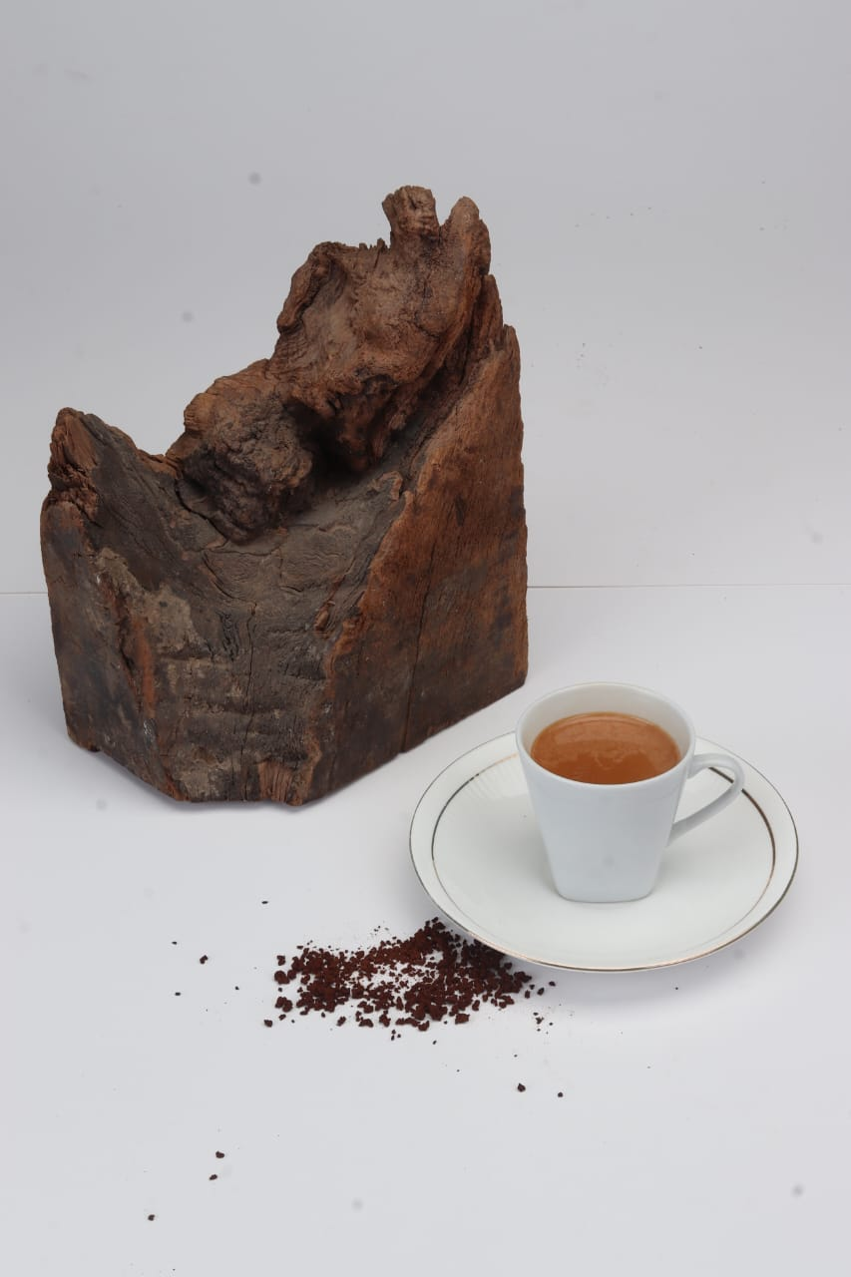
Product Photography:-
Aperture:- F18.0
Shutter:- 1/ 125
ISO:-100

Slide 2
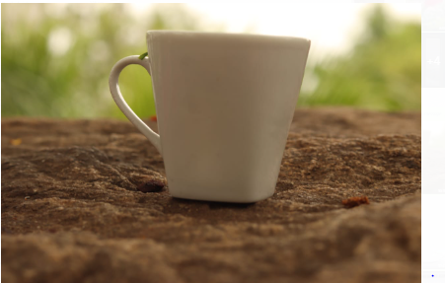
Aperture:-F6.3 Shutter Speed:- 1\125 ISO:-1\100

Slide 3

Aperture:-F6.3 Shutter:-1\125 ISO:-100

Slide 4
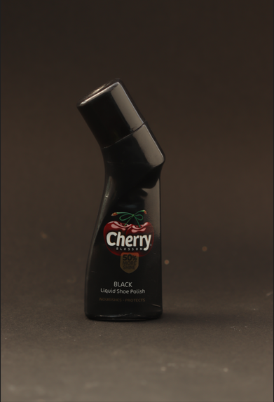
Aperture:-F3.2 Shutter:-1\200 Sec ISO:-100

Slide 5
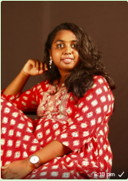
Portrait photography:-
Aperture:-8.0
Shutter:-1/100
ISO:-100

Slide 6
Aperture:-F8.0
Shutter:-1/100
ISO:-100

Slide 7
Aperture:-F4.0 Shuuter:-1/100 ISO:-100

Slide 8
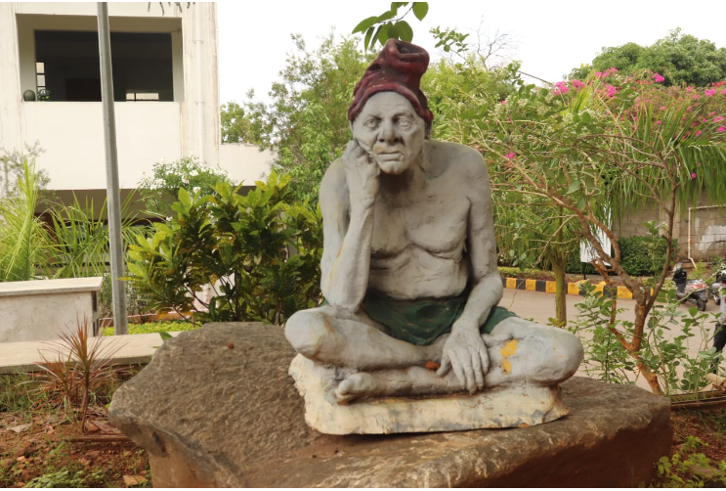
White Balance:-
Aperture:-F10.0
Shutter:-1/200
ISO:-400

Slide 9
Aperture:-F4.5
Shutter:-1\200 sec
ISO:-100

Slide 10
Architectural photography:-
Aperture:-F11.0
Shutter:-1/160
ISO:- 100

Slide 11
Macro Photography:-
Aperture:-F5.0
Shutter:-1/160
ISO:-100

